Slide 1
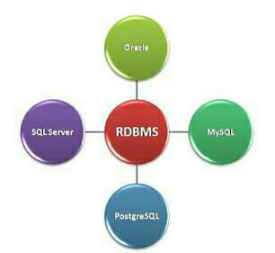
RDBMS
Stands for Relational Data Base Management System.
Data is stored in the form of tables and there is relationship between these tables.

Slide 2
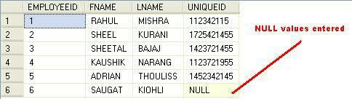
RDBMS Terminologies
Relation – It is a table organized in rows and columns.
Tuple – It is a row of a relation and represents an instance of a relation.
Field – A field is a column in a table that is designed to maintain specific information about every record in a table.
Null – It signifies “no value”.

Slide 3
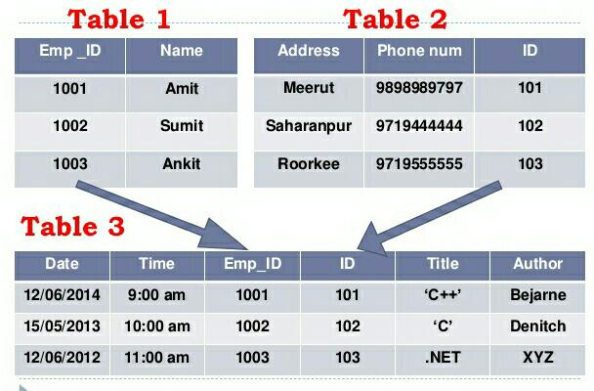
Relationship
Relationship defines how two tables are linked to each other.

Slide 4
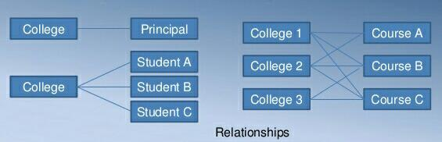
Relationship Types
There are 3 types of relationship :
One-to-one
One-to-many
Many-to-many

Slide 5
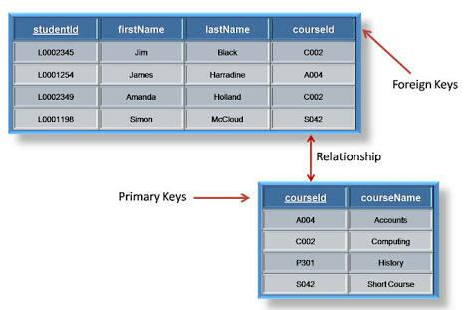
Keys in RDBMS
Primary key - It is a column or group of columns in a table that uniquely
identifies rows in that table.
Foreign key – It is a field in a table that is primary key in another table. It is
used to link two tables.

Slide 6
Constraints
Constraints enforce limits to the data or the type of data that can
be inserted/updated/deleted from a table.
The purpose of constraints is to maintain the data integrity.
Commonly used constraints available in SQL :
NOTNULL Constraints
Unique Constraints
Primary key
Foreign key

Slide 7
EF Codd Rules
Dr. EF Codd proposed thirteen rules and said if DBMS meets these rules, it can be
called as RDBMS.
Rule 0 – Foundation rule
Rule 1 – The information rule
Rule 2 – The guaranteed access rule
Rule 3 – Systematic treatment of null values
Rule 4 – Active online catalog based on relational model
Rule 5 – The comprehensive data sub language rule
Rule 6 – The view updating rule
Rule 7 – High level insert, update and delete
Rule 8 – Physical data independence
Rule 9 – Logical data independence
Rule 10 – Integrity independence
Rule 11 – Distribution independence
Rule 12 – The non subversion rule

Slide 8
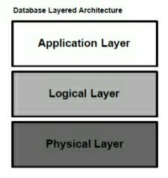
Database Layered Architecture
All database systems, can be viewed as a three layered architecture at the
highest level of abstraction. It has three main components :

Slide 9
Application Layer : It represents the interface for all users of the system; it
essentially provides the means by which outside World can communicate with
database server.
Logical Layer : It is more detailed structure that defines what has to be done to
support the user services. It defines the processes that perform functions and the
information or data flows that are shared between these processes.
Physical Layer : Mainly deals with the storage of variety of information, which is
kept in secondary storage and accessed via the storage manager.

